Slide 1
TECH TALK
Ernie Brigham
Webmaster
Probus Association of Victoria Inc.

Slide 2
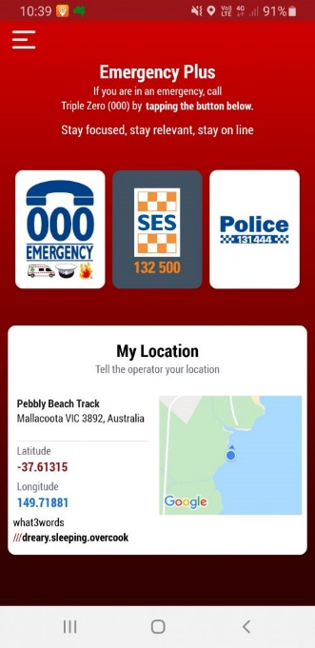
YOU NEED THIS APP ON YOUR PHONE
SAVE THE APP THAT COULD SAVE YOUR LIFE
It’s called Emergency Plus
At the push of a button, you can contact
000, SES & Police
It will tell them where you are
Ernie Brigham
Webmaster
Probus Association of Victoria Inc.

Slide 3
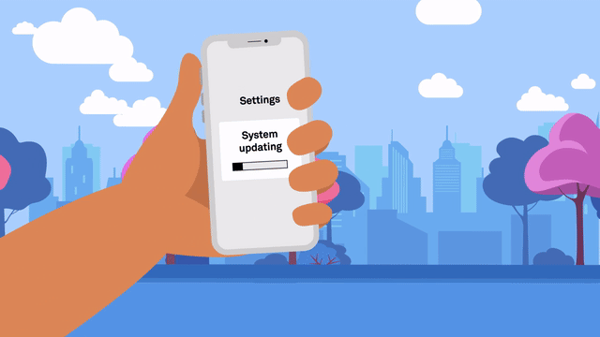
IS YOUR MOBIL PHONE 3G
Australia’s mobile network operators are preparing to switch off their 3G networks to boost the capacity, speed, and reliability of their 4G and 5G networks.
The 3G network switch-off dates:
Telstra will switch off its 3G network on 31 August 2024.
Optus will switch off its 3G network from 1 September 2024.
TPG Telecom/Vodafone has already switched off its 3G network.
How to check if your phone is 3G
If you’re with the Telstra or Optus network, you can text “3” to the number 3498 to receive a response whether your device is impacted.
Ernie Brigham
Webmaster
Probus Association of Victoria Inc.

Slide 4
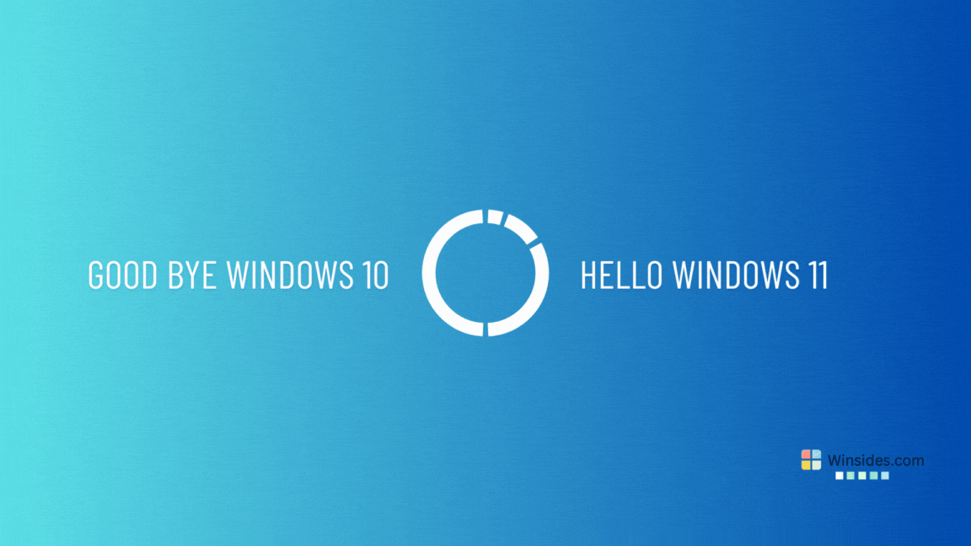
WINDOW 10
Microsoft will officially end support for its most popular operating system on October 14, 2025. Microsoft will no longer provide security updates or technical support. Your computer will still work. Running unsupported Windows versions comes with risks. Without regular security updates, you can be open to cyber-attacks. Here's what you should do with your Windows 10 PCs before that day arrives.
You should look at updating your system to Windows 11.
How much does it cost to upgrade from Windows 10 to Windows 11? It's free. But only Windows 10 PCs that are running the most current version of Windows 10 and meet the minimum hardware specifications will be able to upgrade
Ernie Brigham
Webmaster
Probus Association of Victoria Inc.
Before you do anything, you should do the following
Navigate to Settings > Updates & Security > Check for Updates.

Slide 5
I would like a show of hands
on the following
Would you like me to run a
Zoom training session on HOW To Work On
PSPL Microsite Free Website?
Ernie Brigham
Webmaster
Probus Association of Victoria Inc.

